Slide 1
Data 144: Amazon Reviews Final Project
Notes:
Ashley

Slide 2
01
Problem/Question
02
Dataset
03
Consumer review behavior and rating prediction
Contents
04
Sentiment prediction & Analysis
05
Amazon time review analysis
06
Amazon product recommendation algorithm
07
Conclusions and implications
Notes:
Ashley

Slide 3
Project Context & Motivation
Over 350 million products on Amazon
Sold by Amazon itself: 12 million products
Estimated 300-600 million shoppers on Amazon
233.1 million reviews up to 2018
Can we use reviews to make Amazon better?
Notes:
Leah

Slide 4
Question
How can we better customer satisfaction using their reviews?
Problem
How to understand customer trends and sentiment
towards pet supply products?
Notes:
Leah

Slide 5
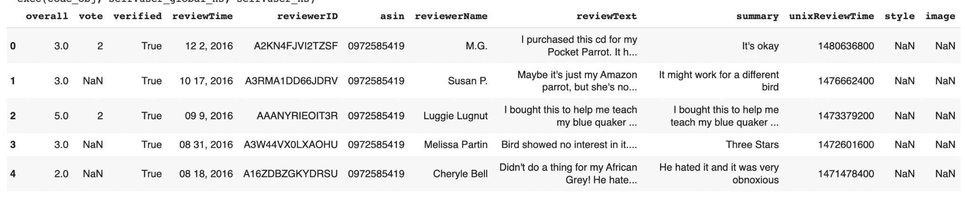
Dataset
Dataset was obtained from https://nijianmo.github.io/amazon/index.html
Chose to do pet supplies in order to have a large, but manageable dataset (2,098,325 reviews)
Data thus consisted of 11 columns (overall, vote, verified, reviewTime, reviewerID, asin, reviewerName, reviewText, summary, unixReviewTime, style, image).
Notes:
Note: We should explain 5-core data (how it is trimmed and if people are using random selection, how that was made)
Junwei

Slide 6
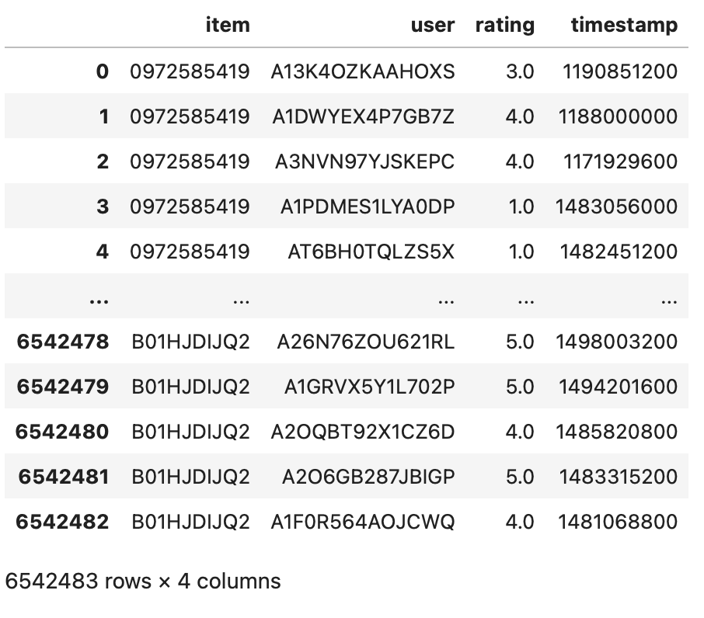
Dataset
Dataset was obtained from https://nijianmo.github.io/amazon/index.html
Pet supplies review data with item ID, user ID, rating, and time stamp (6,542,483 ratings)
Notes:
Note: We should explain 5-core data (how it is trimmed and if people are using random selection, how that was made)
Justifying recommendations using distantly-labeled reviews and fined-grained aspects
Jianmo Ni, Jiacheng Li, Julian McAuley
Empirical Methods in Natural Language Processing (EMNLP), 2019

Slide 7

Consumer Review Behavior Analysis & Rating Prediction

Slide 8

Motivation
Review grouping
Exploring the variety of reviews
Identify the most common pet types among consumers
Identify similar characteristics of reviews among products
How different are the review?
What kind of products are being reviewed?
Provide further information about the dynamics of the reviews (outlier reviews)
Cluster the different reviews for potential product recommendation
Notes:
Junwei: clustering the different reviews based on their characteristics could set the stage for product recommendation models

Slide 9
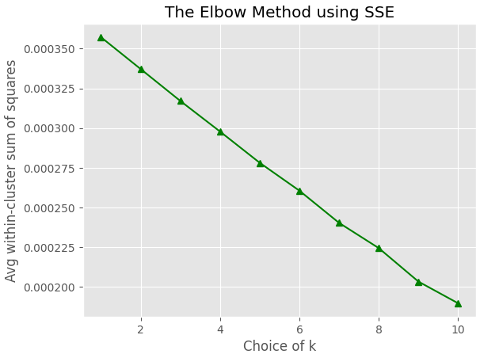
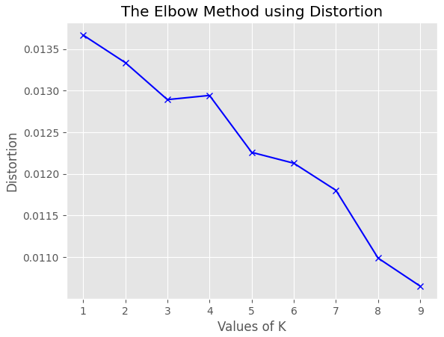
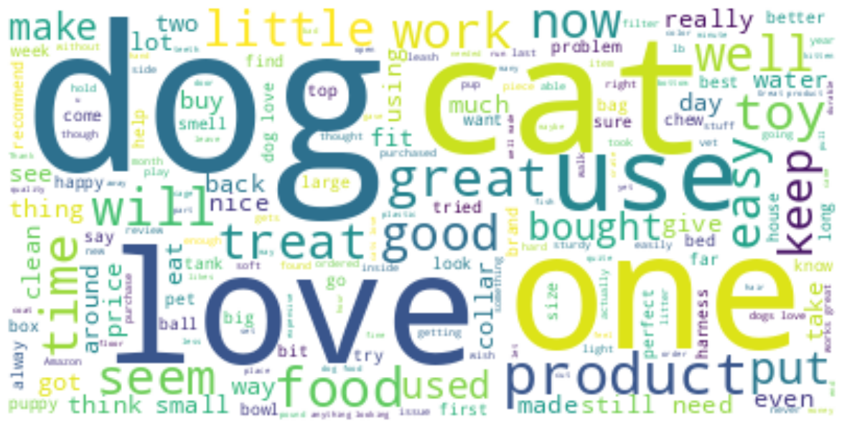
Methods
Pre-processing
Remove reviews w/ NaN features
Create word clouds for review texts
Choose most common words with strong sentiments or pet type or supply type as features
Used pd.get_dummies to encode the selected words
Ex: ‘dog, 'cat', 'love', 'toy', 'bad', 'great'
Stars, votes, verified, review time as other features
Model
Normalization across all columns
Apply K-Mean Clustering
Use the Elbow Method to tune the optimal K
Utilize PCA to visual the clusters in 2D & 3D
Notes:
Junwei

Slide 10
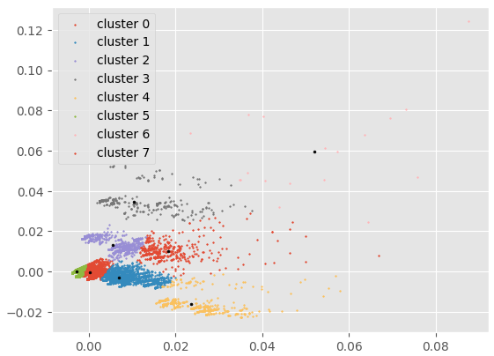
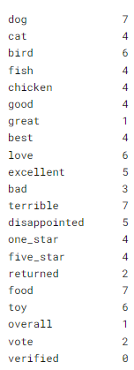
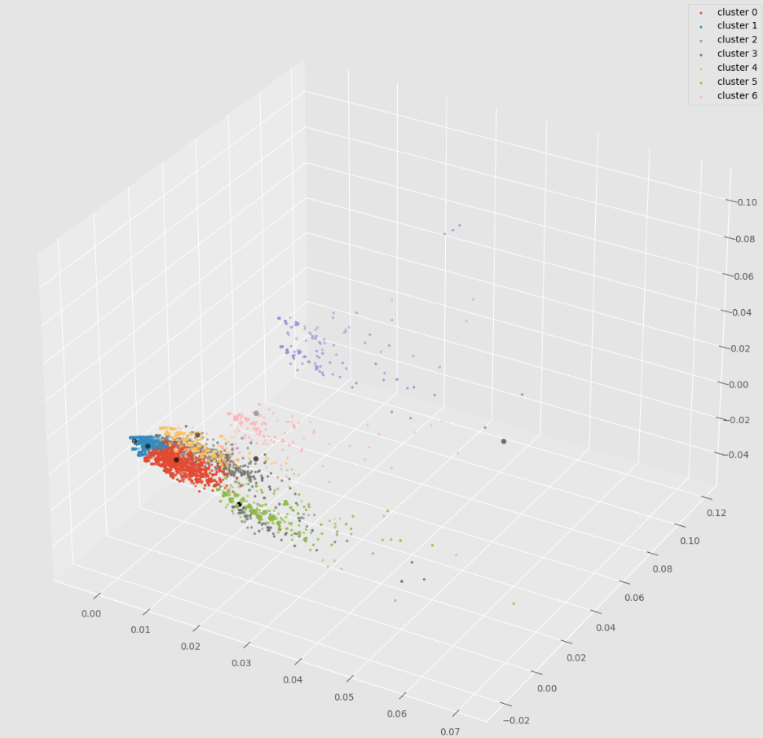
Results
Most reviews are concentrated in the lower left corner
There are reasonable amounts of outlier reviews
There are many similarities among reviews
Cluster 0 contains the most reviews
Cluster 1 has the highest average star
Cluster 4 on average has the most ‘one star’ and ‘five star’
Food & toy reviews are rather scattered (yellow & orange)
Cluster 7 has the most ‘dog’ but also an outlier
Notes:
Junwei

Slide 11
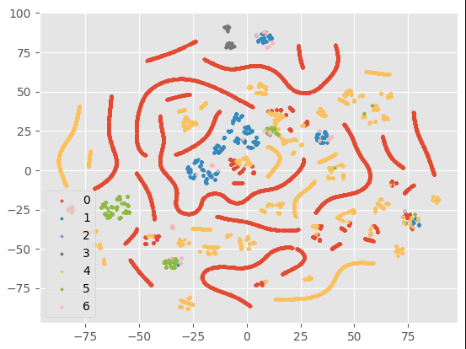
Results
Exploring the variety of reviews
Dimensionality Reduction using TSNE
Reviews seem to be very different
Notes:
Junwei

Slide 12
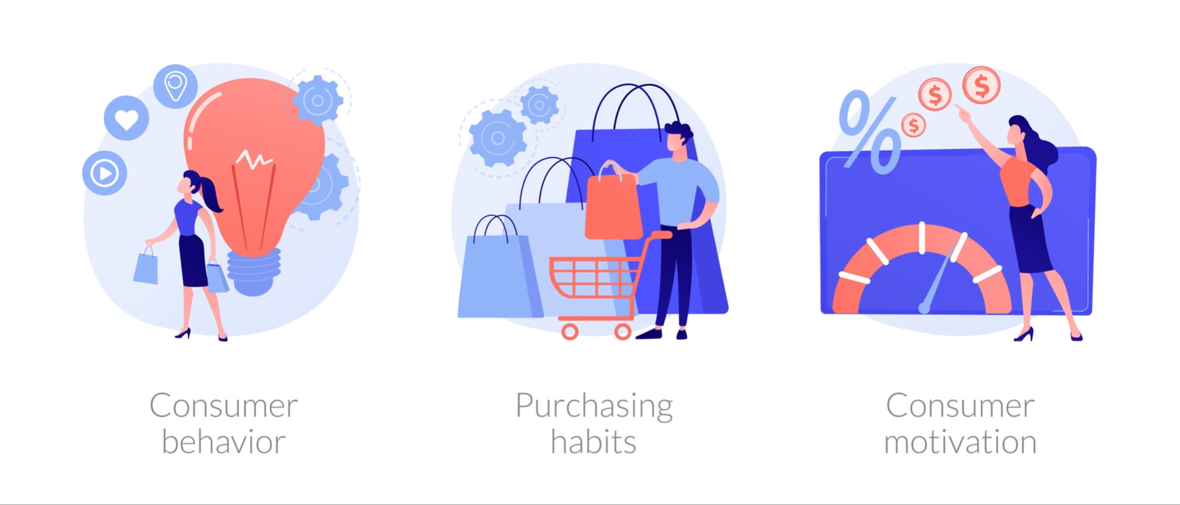
Motivation
Rating prediction
Reviews are important factor in making purchasing decisions
However not all reviews are trustworthy
Research Question 1: Do certain group of consumers have different patterns of reviews?
Research Question 2: Can we use reviews to group certain products together?
Notes:
Up to 84% of consumers noted that reviews were important in their purchasing decisions.
Leah

Slide 13
Methods
Grouped by users or by products using rating only dataset
Preprocessing:
Percent count for each of the ratings, number of reviews, mean, min, max, standard deviation of reviews and normalization
Models
Elbow method for choosing number of clusters
K-mean clustering analysis and TSNE for visualization
Used centroids to explain the rating patterns of products and of users
Notes:
Leah

Slide 14
Results
Most 1-time review users are positive (mostly gives 5 star ratings)
Product clustering: 6 clusters - 1-star, 2-star, 3-star, 4-star, 5-star reviewed items, and a cluster with highly variable reviews
User clustering: 6 clusters - 1-star, 2-star, 3-star, 4-star, 5-star review users and a cluster of users with variable, many reviews
Given clusters for users and products,
Able to use neural network/decision tree to predict accuracy of 80%
Potential benefit: We can use this method to expose reviews by certain customers and expose products with high trustworthy review ratings.
Notes:
Leah

Slide 15
Next step:
Clusters would benefit greatly from knowing the name of each product in the dataset
The dataset only contains the ASIN
Explore other clustering techniques
Ex: Spectral Clustering, Hierarchical Clustering
More computing power - because of the large size, not all review text were used
Visualization - TSNE dimensionality reduction did not help with under
Demographics of users could be interesting to look into
Notes:
Leah:
Additional note: TSNE - dimentionsality reduction
No way of knowing what product each review is reviewing for

Slide 16
Sentiment Analysis & Prediction

Slide 17
Motivation
“Sentiment” analysis
Amazon's ranks reviews based on how many thumbs up they get
But products could change overtime
Goal: Predict and analyze people's opinions on products change over time
Stakeholders: Sellers and amazon quality control can benefit by observing buyers’ sentiment on products over time and better regulate/control the quality of products.
3 approaches: Decision Trees, Naive Bayes Classifier, and Word2Vec
Notes:
Up to 84% of consumers noted that reviews were important in their purchasing decisions.
Making the assumption that Sentiment are directly related the words in reviews and the numeric ratings

Slide 18
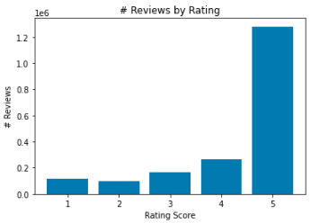
Methods
Assumption
Sentiments are reflected by ratings
3 Sentiments: Positive (four and five stars), Neutral (three stars), and Negative (one and two stars)
Preprocessing
Dataset split into training, validation, and test data to avoid overfit
80,000 randomly sampled rows from each sentiment
Use bag of words to turn the reviews into numerical vectors
Tokenization (split sentence to words)
Stopwords (get rid of common words with no effect on sentiment)
Naive Bayes Classifier- a simplified version of Bayes Theorem, where all features are assumed independent to each other
Notes:
First I’ll be talking about Naive Bayes Classifier
Before we start talking about the training

Slide 19
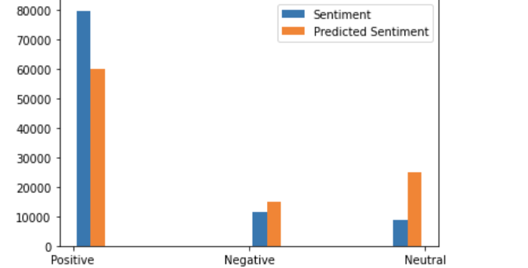
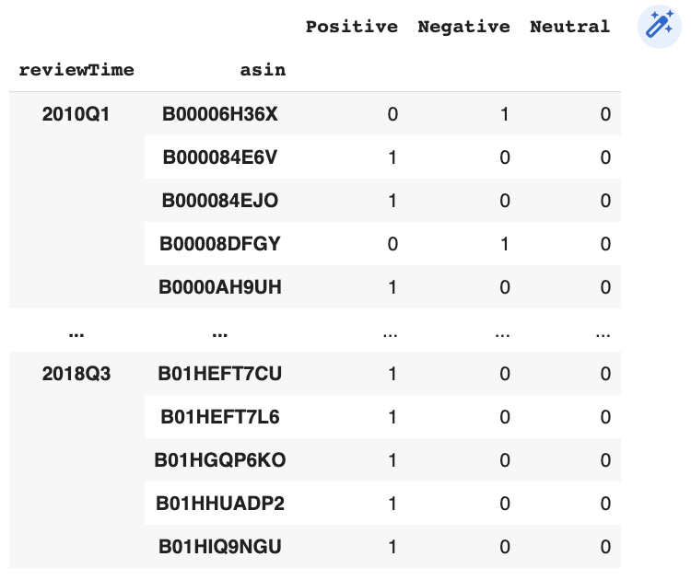
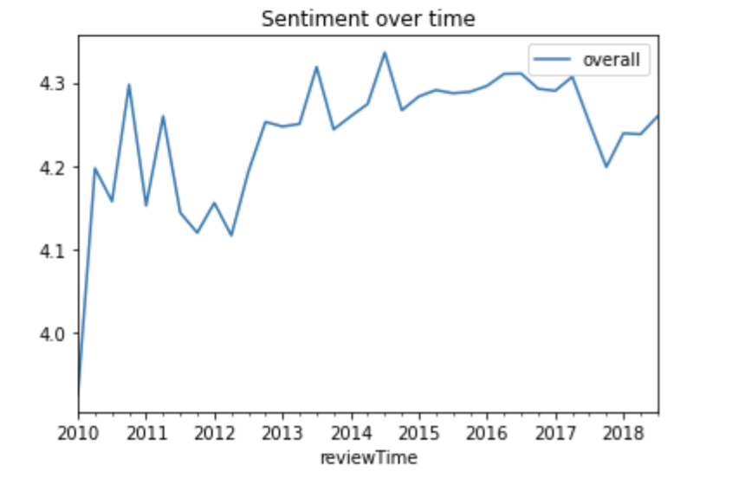
Results
Achieved about 72% accuracy on the test set of 100,000 reviews
Accuracy would be higher if didn’t sample equally from each sentiment, but would predict everything as positive

Slide 20
Methods
Classify sentiments by ratings
4-5 stars → Positive, 3 stars → Neutral, 1-2 stars → Negative
Preprocessing
Data sampling ~ 25000/class, Tokenization, Stopwords, Lemmatization, Vectorization
Models
Trained Word2Vec, then converted to matrix of vectors to pass into a Keras Sequential model embedding layer as the weights. (Embedding → Flatten → Dense)
Word Embedding with Keras Sequential (Embedding → Bidirectional LTSM → Dense)
EDA
Upon charting the distribution of ratings, there is a noticeable imbalance between positive and the other two class ratings.

Slide 21
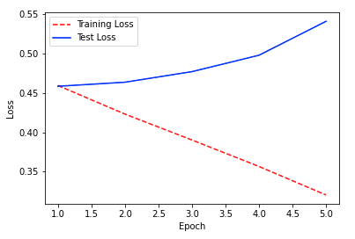

Results
Areas of Improvement / Next Steps
Amend overfitting – on the right are the learning curves of the training and validation sets in the word embedding model (5 epochs, 250 batches in interest of available resources)
Training word2vec on the reviews and using the created matrix in an mlp only returned ~0.3 accuracy, while the word embedding instance peaked in the first epoch with a validation accuracy of 0.7952.
Predictions seemed relatively consistent for earlier years and fluctuated more in recent years, which is likely the result of overfitting → → →
Potential Starting Points –
⓵ Reducing huge amount of free parameters, which embedding layers expand.
⓶ Adding dropouts (recurrent_dropouts for keras) to the LTSM input nodes.
⓷ Add early stopping and L1 or L2 regularization (adds penalty to the loss function).
Explore bigrams and trigrams using gensim library’s Phrases model –
Currently only look at unigrams; bigram and trigram phrases can introduce another level of context and insight of the text’s meaning.
Notes:
Conclusions: phrases into account with gensim bigrams and trigrams(?)
Word Embedding high pain without GPU acceleration

Slide 22
Motivation
Using review text to predict sentiment
Approach: One-hot encode words in the review text as part of feature engineering and use this to predict sentiment
Amazon can benefit from this by figuring out what keywords are associated with certain sentiments
Can also gain insight into how helpful reviews are

Slide 23
Methods
Same assumption that sentiment is reflected by ratings
Pre-processing
Changed all review text data to lowercase
Analyzed review text to pick out common words that were most likely to indicate sentiment
Ex: 'Great', 'love', 'Perfect', 'favorite', 'bad', 'dislike'
Used pd.get_dummies to encode the selected words
Models
Fit a decision tree classifier and random forest classifier on the dataset

Slide 24
Results
Both models were found to have a final accuracy of ~82% accuracy on the test set after modifying the chosen encoded words
Found that the model was biased towards predicting a positive sentiment (99% of predicted sentiments were positive)
Takeaway 1: Sentiment might be more easily predicted when ratings are positive (should attempt to predict sentiment when it has a more even distribution)
Takeaway 2: Words like ‘great’, ‘favorite’, and ‘love’ were good predictors of positive sentiment

Slide 25
Amazon Time Review Analysis

Slide 26

Motivation
See how many purchases on average people were buying and reviewing
When people seemed to review the most products
Predict when was the most beneficial time to ensure products are well stocked in regards of reviews
We assume people would buy/review the most before major holidays

Slide 27
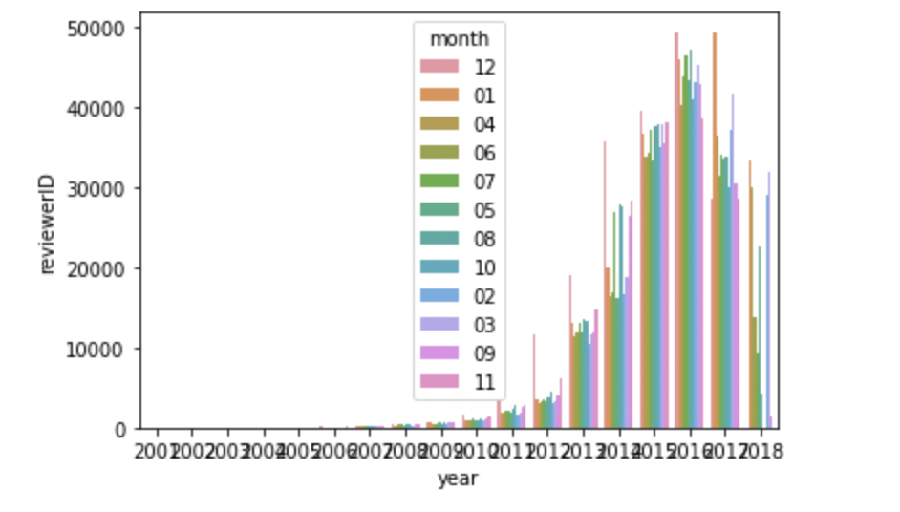
Methods
Data cleaning: Extract date information by using regex
Grouping data by year and month in order to see purchasing patterns
Plot trends
Train logistic regression model on data

Slide 28
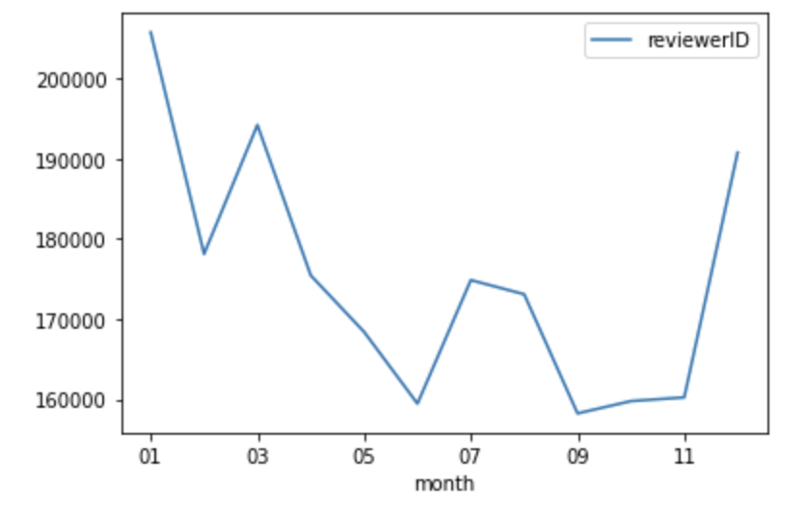
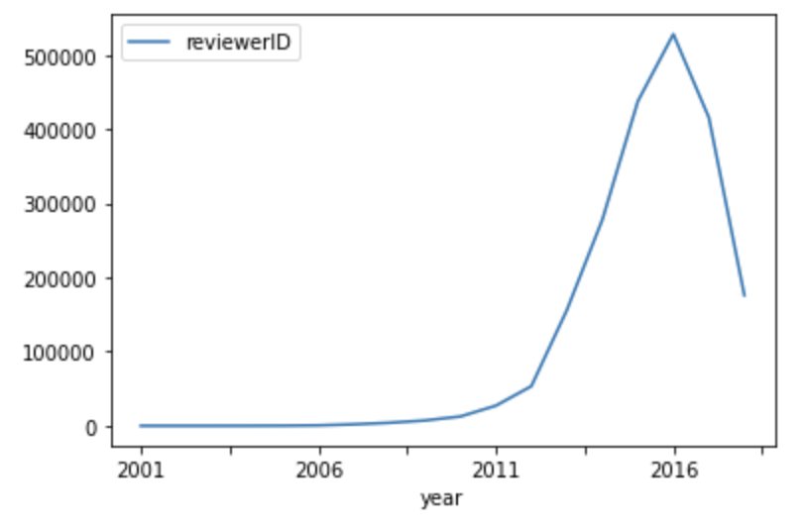
Results
Pet supplies did peak before major holidays, and throughout winter and then again in summer.
From our yearly trend, we see that the reviews peaked in 2017, but since our data ends sometime in 2018, we cannot confirm whether this will significantly affect our trends
Notes:
We were able to conclude that pet supplies did peak before major holidays, and throughout winter and then again end of summer. This in part can be attributed to exclusive deals in amazon. We also believe that some pet owners may wait until january to purchase in order to get better deals on the over stocking of many companies. Logistic regression model had about a 60% accuracy on predicting when consumers would review a purchased product.

Slide 29
Amazon Product Recommendation Algorithm

Slide 30
Motivation
A recommendation system can push engagement and retention and help customers find items they want but didn’t specifically know they wanted
Research Question 1: What are the closest items that can be clustered with a chosen item?
Research Question 2: Can we use reviews/previous reviews to group certain products together?
Potential benefit: We can use find frequently bought together items and recommend them to other customers of those products.
Notes:
Up to 84% of consumers noted that reviews were important in their purchasing decisions.

Slide 31
Methods
Items are one hot encoded based on which reviewer reviewed it and what review it got based on star
Skip-gram is used to rank item similarity to each other where instead of letters, the whether or not it got reviewed by a certain reviewer is used
A collection of products can be placed together using clustering and display all similar products

Slide 32
Results
Any number of recommendations can be given for products with reviews.
The same method can be expanded to all users purchase history to every product
The product clustering can also be used as an addition to search
More product data could improve the recommendations.
History of returns or dissatisfaction could also be used

Slide 33
Conclusions &
Implications

Slide 34
Conclusions & Implications
We were able to capture some rating patterns using K-means clustering and have good accuracy in sentiment prediction
Gain more data in order to better understand trends
Our project is not ready for real life application but has potential for improving Amazon’s product placement, review exposures, and encouraging user involvement with reviews
Notes:
We’ve explored review data in many different aspects

Slide 35
thanks!

Slide 36
John
References
Justifying recommendations using distantly-labeled reviews and fined-grained aspects
Jianmo Ni, Jiacheng Li, Julian McAuley
Empirical Methods in Natural Language Processing (EMNLP), 2019
https://www.businessofapps.com/data/amazon-statistics/

